Slide 1


The Development of Flight Operations:
Improvement of ERAU Cube-Sat’s Ground System Interface and Research of the Satellite’s Orbital Decay
Presented by Madison Padilla
Embry-Riddle Aeronautical University, Prescott
EagleSat-1 Flight Operations Team Lead
Mentor: Dr. Gary Yale

Slide 2
Outline
Background
Ground system overview
Ground system breakdown
Graphic user interface (GUI) layout
Flight dynamics overview
Analysis from Flight Dynamics
Questions

Slide 3
Background
The research and development has been done for the ERAU-Prescott cubesat, known as the EagleSat-1
Technical Objective:
  To improve and complete the ground system and to calculate and incorporate drag in order to predict the deorbit time of the EagleSat-1

Slide 4
Ground System
A ground system to provide a Graphical User Interface (GUI) with EagleSat-1 through a serial connection to the Terminal Node Controller (TNC)
View, save, observe and process data from EagleSat-1
Send commands to EagleSat-1
Transformational and Interactive Software Architecture
Matrix Laboratories (MATLAB) chosen for all ground station software

Slide 5

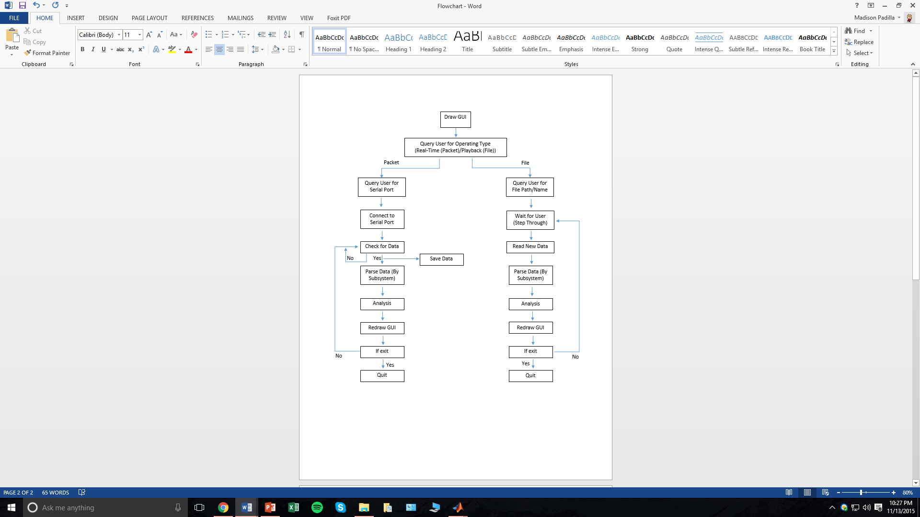
High Level Flowchart

Slide 6
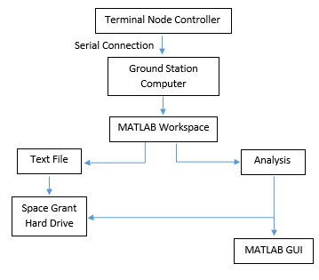
Data Flow Diagram

Slide 7
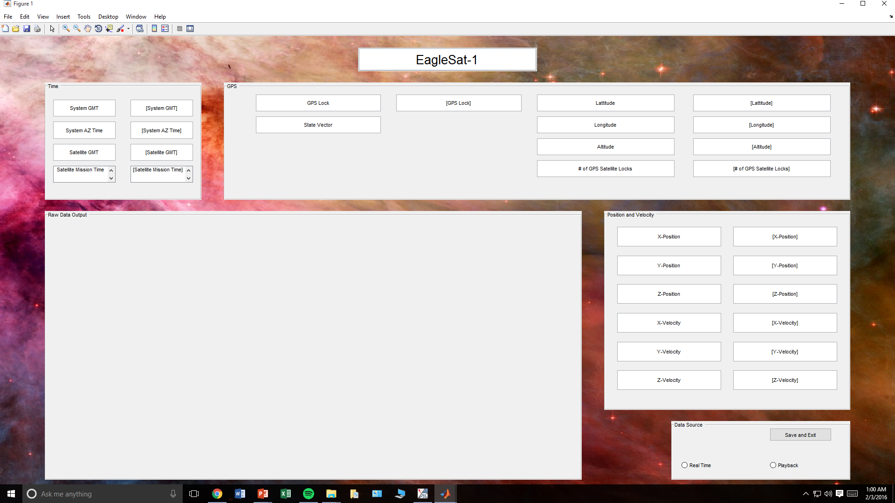
1. Time
2. GPS
3. Raw Data Output
4. Position and Velocity
Position and Velocity
  X, Y, Z position
  X, Y, Z velocity
5. Data Source
  Buttons for real-time or playback
  Save and exit
2. GPS
  GPS Lock
  State Vector
  Latitude and Longitude
  Altitude
  Number of satellite locks
Time
  System Greenwich Mean Time (GMT)
  System AZ Time
  Satellite GMT
  Satellite Mission Time
3. Raw Data Output
5. Data Source

Slide 8
Flight Dynamics
Main objective: To calculate and incorporate drag in order to predict the deorbit time on the EagleSat-1
Orbital Predictions:
  Altitude at apogee: 810 km
  Altitude at perigee: 450 km
  Inclination: 99.72 degrees
  Mean Local Time of Ascending Node: 13:35
  Assumed launch date: January 16, 2017
All flight dynamics analysis is done in Systems Tool Kit 10 (STK)

Slide 9
STK Analysis - Coverage
Passes over Ground Station (located in AXFAB)
  3 to 6 passes per day
  2-3 passes within ~1-2 hours, separated by ~8-10 hours
  Mean coverage time: approximately 10 minutes
Example of STK coverage generation file, based upon assumed launch date
Place-Embry_Riddle_Aeronautical_University_AZ-To-Satellite-EagleSat1: Access Summary Report
Embry_Riddle_Aeronautical_University_AZ-To-EagleSat1
----------------------------------------------------
Access Start Time (UTCG) Stop Time (UTCG) Duration (sec)
------ ------------------------ ------------------------ --------------
1 15 Dec 2016 19:31:13.539 15 Dec 2016 19:46:23.716 910.177
2 15 Dec 2016 21:12:50.416 15 Dec 2016 21:24:14.212 683.796
3 16 Dec 2016 08:04:57.043 16 Dec 2016 08:09:15.595 258.552
4 16 Dec 2016 09:39:02.660 16 Dec 2016 09:53:40.951 878.291
5 16 Dec 2016 11:19:44.346 16 Dec 2016 11:33:58.346 854.000

Slide 10
Eclipse Times
Eclipse Analysis, based upon assumed launch date 01/16/17
  Eclipse duration: 8 seconds to 40 minutes
  Average eclipse duration: 9.18 minutes
  Example of STK eclipse summary:
Start Time (UTCG) Stop Time (UTCG) Duration (sec)
------------------------ ------------------------ -------------------
16 Jan 2017 19:00:00.000 16 Jan 2017 19:22:53.407 1373.407
16 Jan 2017 19:22:53.407 16 Jan 2017 19:23:02.685 9.279
…
16 Jan 2019 18:32:26.202 16 Jan 2019 18:32:34.855 8.654
16 Jan 2019 18:32:34.855 16 Jan 2019 19:00:00.000 1645.145

Slide 11
Questions?

